Slide 1
File-System Interface

Slide 2
File-System Interface
File Concept
Access Methods
Directory Structure
File Sharing
Protection

Slide 3
File Concept
Contiguous logical address space
Types:
Data
numeric
character
binary
Program

Slide 4
File Structure
Sequence of words, bytes
Simple record structure
Lines
Fixed length
Variable length

Slide 5
File Attributes
Name – only information kept in human-readable form
Identifier – unique tag (number) identifies file within file system
Type – needed for systems that support different types
Location – pointer to file location on device
Size – current file size
Protection – controls who can do reading, writing, executing
Time, date, and user identification – data for protection, security, and usage monitoring
Information about files are kept in the directory structure, which is maintained on the disk

Slide 6
File Operations
File is an abstract data type
Create
Write
Read
Reposition within file
Delete
Truncate
Open(F_{i}) – search the directory structure on disk for entry F_{i}, and move the content of entry to memory
Close (F_{i}) – move the content of entry F_{i} in memory to directory structure on disk

Slide 7
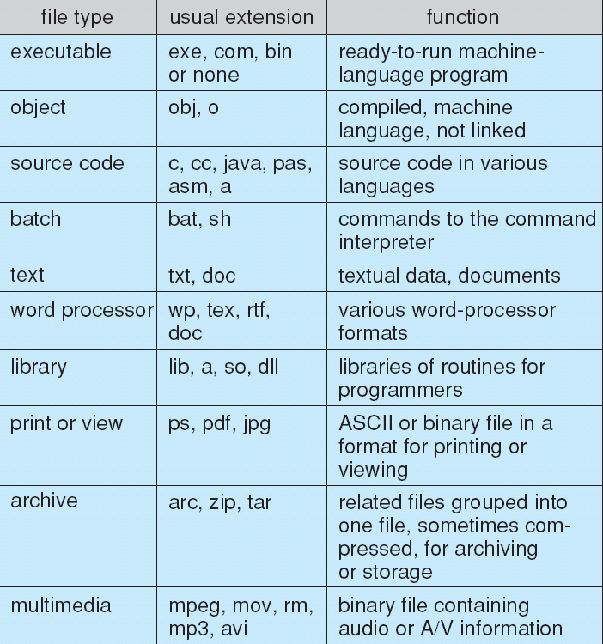
File Types – Name, Extension

Slide 8
Access Methods
Sequential Access
read next
write next
reset
rewrite
Direct Access
read n
write n
position to n
read next
write next
rewrite n
n = relative block number

Slide 9
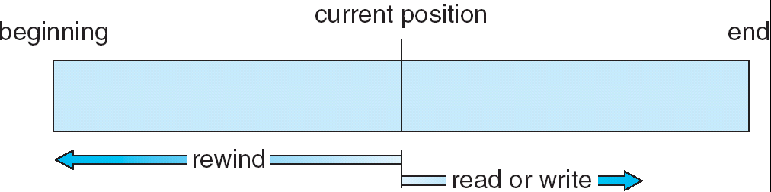
Sequential-access File

Slide 10
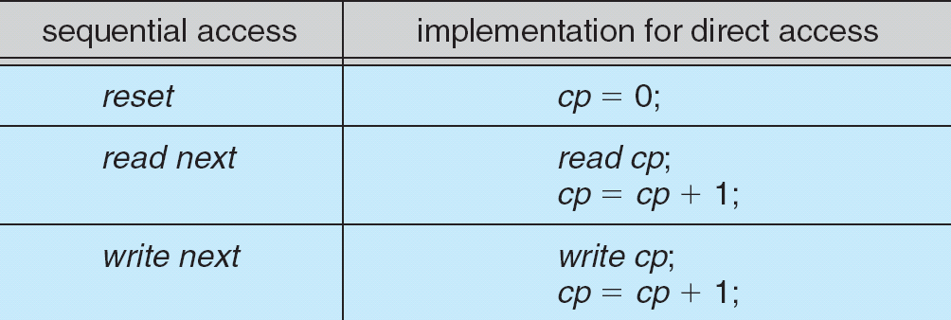
Simulation of Sequential Access on a Direct-access File

Slide 11
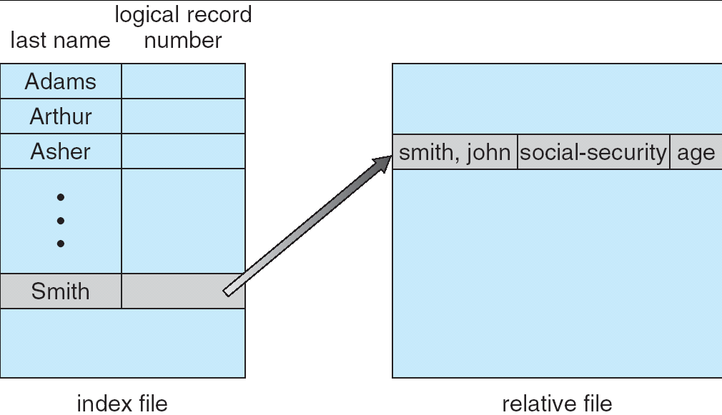
Example of Index and Relative Files

Slide 12
Directory Structure
A collection of nodes containing information about all files
Directory
Files
F 1
F 2
F 3
F 4
F n
Both the directory structure and the files reside on disk

Slide 13
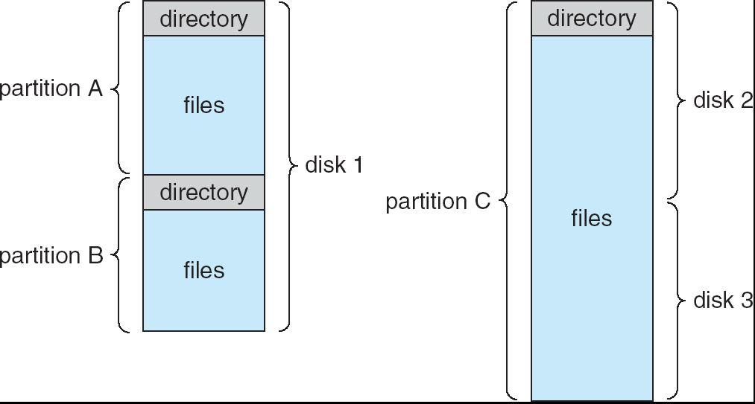
A Typical File-system Organization

Slide 14
Operations Performed on Directory
Search for a file
Create a file
Delete a file
List a directory
Rename a file
Traverse the file system

Slide 15
Organize the Directory (Logically) to Obtain
Efficiency – locating a file quickly
Naming – convenient to users
Two users can have same name for different files
The same file can have several different names
Grouping – logical grouping of files by properties, (e.g., all Java programs, all games, …)

Slide 16
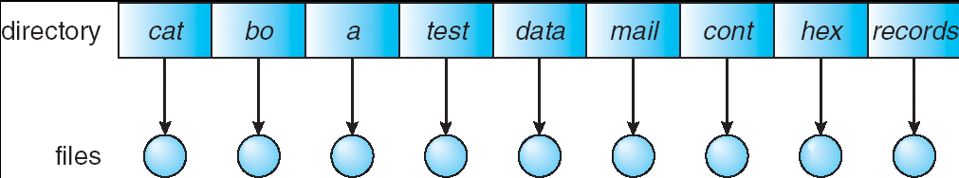
Single-Level Directory
A single directory for all users
Naming problem
Grouping problem

Slide 17
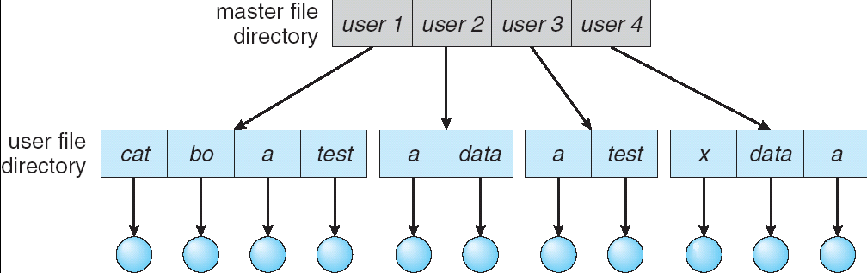
Two-Level Directory
Separate directory for each user
Path name
Can have the same file name for different user
Efficient searching

Slide 18
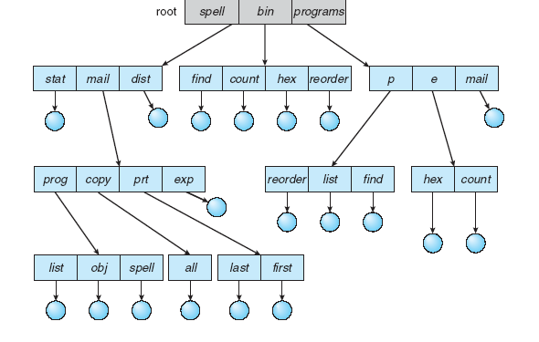
Tree-Structured Directories

Slide 19
Tree-Structured Directories (Cont)
Efficient searching
Grouping Capability
Current directory (working directory)
cd /spell/mail/prog
type list

Slide 20
Tree-Structured Directories (Cont)
Absolute or relative path name
Creating a new file is done in current directory
Delete a file
rm <file-name>
Creating a new subdirectory is done in current directory
mkdir <dir-name>
Example: if in current directory /mail
mkdir count
mail
prog
copy
prt
exp
count
Deleting “mail” ⇒ deleting the entire subtree rooted by “mail”

Slide 21
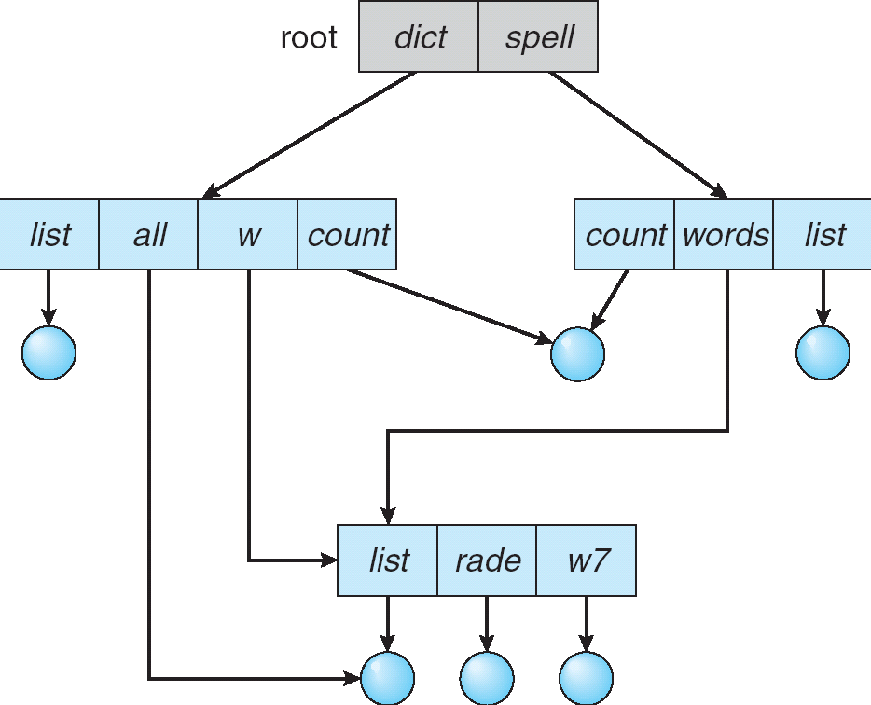
Acyclic-Graph Directories
Have shared subdirectories and files

Slide 22
Acyclic-Graph Directories (Cont.)
Two different names (aliasing)
If dict deletes list ⇒ dangling pointer
Solutions:
Backpointers, so we can delete all pointers Variable size records a problem
Backpointers using a daisy chain organization
Entry-hold-count solution
New directory entry type
Link – another name (pointer) to an existing file
Resolve the link – follow pointer to locate the file

Slide 23
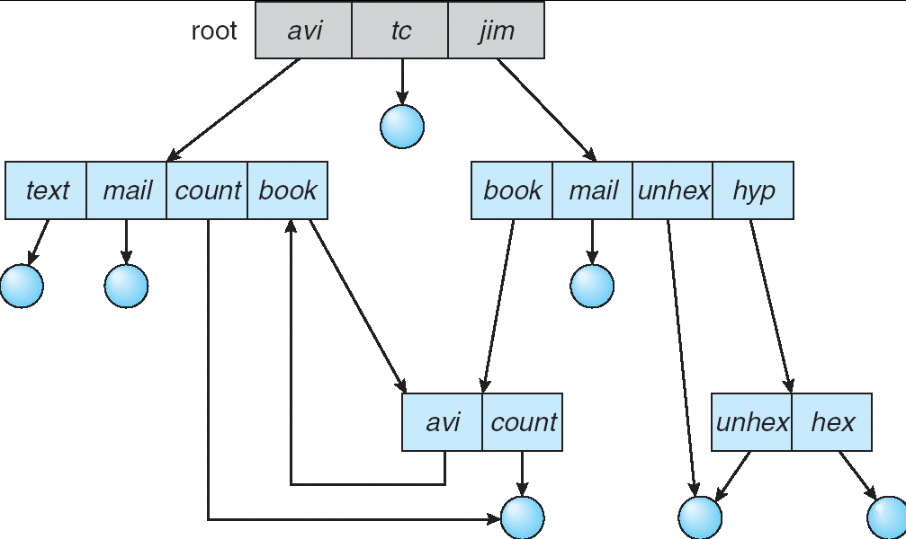
General Graph Directory

Slide 24
File Sharing
Sharing of files on multi-user systems is desirable
Sharing may be done through a protection scheme
On distributed systems, files may be shared across a network
Network File System (NFS) is a common distributed file-sharing method

Slide 25
File Sharing – Multiple Users
User IDs identify users, allowing permissions and protections to be per-user
Group IDs allow users to be in groups, permitting group access rights

Slide 26
File Sharing – Remote File Systems
Uses networking to allow file system access between systems
Manually via programs like FTP
Automatically, seamlessly using distributed file systems
Semi automatically via the world wide web
Client-server model allows clients to mount remote file systems from servers
Server can serve multiple clients
Client and user-on-client identification is insecure or complicated
NFS is standard UNIX client-server file sharing protocol
CIFS is standard Windows protocol
Standard operating system file calls are translated into remote calls
Distributed Information Systems (distributed naming services) such as LDAP, DNS, NIS, Active Directory implement unified access to information needed for remote computing

Slide 27
Protection
File owner/creator should be able to control:
what can be done
by whom
Types of access
Read
Write
Execute
Append
Delete
List

Slide 28
Access Lists and Groups
Mode of access: read, write, execute
Three classes of users
RWX
a) owner access 7 ⇒ 1 1 1 RWX
b) group access 6 ⇒ 1 1 0
RWX
c) public access 1 ⇒ 0 0 1
Ask manager to create a group (unique name), say G, and add some users to the group.
For a particular file (say game) or subdirectory, define an appropriate access.
owner
group
public
chmod
761
game
Attach a group to a file chgrp G game

